Slide 1




Nestlé’s Global Scale
Highlight Nestlé’s vast operations with over 2,000 brands in 188 countries and sales of more than one billion products a day.
by flayson junio pereira santos

Slide 2
20-Year Partnership with SAP
1
Strengths
Identifying your strengths is the first step in leadership development. It's important to understand what you're naturally good at and where your skills lie. This can help you focus on areas where you can excel and contribute the most.
2
Goal Setting
Setting achievable goals is a crucial part of leadership development. Goals give you a clear direction and a target to aim for. They help you measure progress and keep you motivated. Remember to make your goals SMART - Specific, Measurable, Achievable, Relevant, and Time-bound.
3
Tools & Resources
Gathering the right tools and resources is essential for effective leadership development. This could include books, courses, mentors, and real-world experiences. The right resources can provide valuable insights and help you develop the skills you need to be an effective leader.

Slide 3
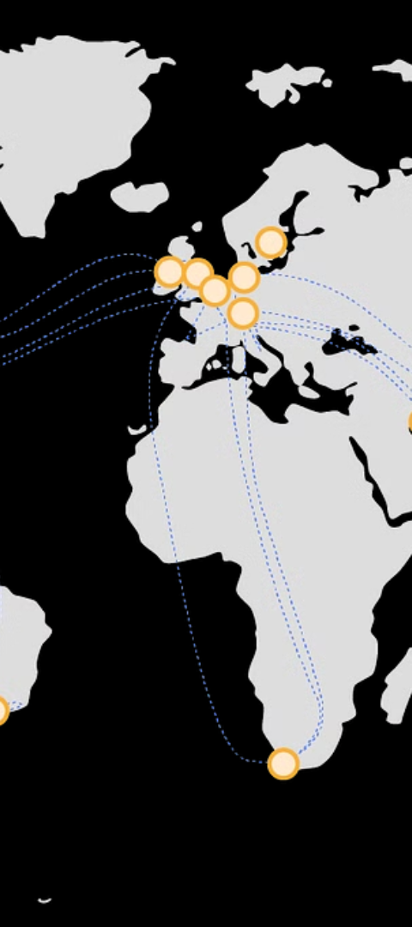
Global Complexity & IT Infrastructure
1
Global Complexity
2
Consumer Expectations
Emphasize the need for a solid IT infrastructure to support Nestlé’s large scale and complexity.
Note the shift in consumer expectations and the acceleration of digital commerce.

Slide 4

RISE with SAP Solution
RISE with SAP
1
Introduce the RISE with SAP solution for a smooth transition to a dynamic, reliable, and scalable infrastructure.
2
Cloud Integration
Discuss the integration of cloud solutions and their impact on analytics and employee access to SAP applications.

Slide 5
Positive Results
IT Improvements
HR Transformation
Share the increased system availability and reduced outage times.
Highlight the automation of HR processes and the implementation of SAP SuccessFactors.

Slide 6
Future Plans & Consumer Experience
1
Consumer Experience
2
Sustainability Efforts
Talk about the increase in direct-to-consumer business and the plans to migrate all operations to SAP S/4HANA Cloud.
Mention Nestlé’s use of SAP to optimize processes for sustainability goals.

Slide 7

Continued Growth & Expansion
1
Global Expansion
2
Technological Advancements
Discuss Nestlé's plans for continued global expansion and market growth.
Highlight the role of technological advancements in driving future growth and innovation.

Slide 8

Community Engagement & Social Responsibility
1
Community Engagement
2
Social Impact
Discuss Nestlé's commitment to community engagement and social responsibility initiatives.
Highlight the positive social impact of Nestlé's initiatives and partnerships.

